Slide 1
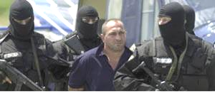
Trafficking in Human Beings
(THB)
A threat to security and stability
Module for Military Commanders & Civilian Leaders

Slide 2
What we will discuss today …
NATO Policy on Combating THB
What is trafficking in human beings?
Traffickers & victims
Characteristics of organized crime
Your responsibility as Commanders & Supervisors
Reporting misconduct of personnel

Slide 3
Introduction
NATO missions typically involve creating and maintaining a safe and secure operating environment
Historically, once active combat has ended the greatest threat to this objective has been organized crime ...

Slide 4
Forces of Instability
Intelligence indicates the three largest criminal activities and sources of funding for organized crime is trafficking in:
  Narcotics
  Human beings
  Weapons

Slide 5
The problem is serious !!!
27 million people are enslaved in some form worldwide – more than at any time in history
Up to 4.000.000 people are said to be trafficked annually, the majority of whom are women and children
Estimated revenues of this criminal activity are believed to amount up to 12 billion Euro per year

Slide 6
NATO’s Policy on Combating Trafficking in Human Beings
Zero-tolerance policy: NATO-led forces are prohibited from engaging in or facilitating trafficking in human beings
Support for host nation: NATO-led forces will support within their competence and mandate the efforts of the host country to combat trafficking in human beings
NATO Policy on Combating Trafficking in Human Beings
EAPC(C)D(2004)0029 (8 June 2004)

Slide 7
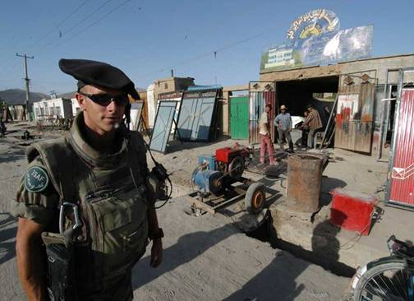
What led NATO to adopt its anti-trafficking policy?
Mission accomplishment
  Security
  Credibility

Slide 8
Trafficking in human beings is ...
. . . the recruitment, transportation, transfer, harboring or receipt of persons, by the threat or use of force, deception or other means, for the purpose of exploitation.
(Art. 3, UN Trafficking Protocol)

Slide 9
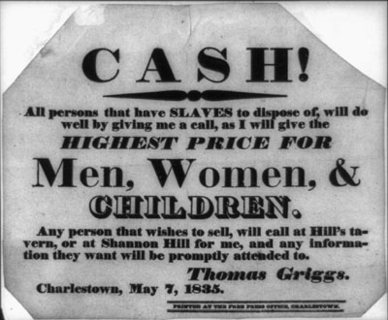
Elements of THB
- recruitment
- transfer
- harbouring
- receipt of persons
ACTS
threat or use of
- force
- deception
- coercion
- abuse of power
MEANS
- sexual exploitation
- forced labour
- slavery
- begging
- removal of organs
- etc
PURPOSE

Slide 10
The exploitation of children
(under 18 years of age)
is always a crime!
UN Trafficking Protocol

Slide 11
The many faces of trafficking in human beings ...
Forgery of documents
Corruption
Money laundering
Tax evasion
Illegal detention
Trafficking in Human Beings
Forced labour
Exploitation of labour
Debt-bondage
Kidnapping
Forced marriage
Murder
Forced abortion
Bodily injury
Slavery
Sexual assault
Torture
Rape
Cruel, degrading or inhumane treatment

Slide 12
Trafficking is a Process . . .
Recruitment
Transportation
Exploitation
Place of Origin
Place of Destination

Slide 13
Compare & Contrast:
Smuggling of Migrants (SoM) v. Trafficking in Human Beings (THB)
SoM
⇩
Facilitation of illegal border crossing for financial or other material benefit
Crime against the state
THB
⇩
Threat or use of force, deception or other means to subject a person to EXPLOITATION
Crime against an individual

Slide 14
Organised crime in the AOR ...
Fraud
Money laundering
Protection rackets
Front Companies
Smuggling
Trafficking
Crime
Business
NATO-led Forces
are confronted with
Bribery
Corruption
Partiality
Bribery
Cronyism
Economic espionage
Monopoly
Protection
State Authorities

Slide 15
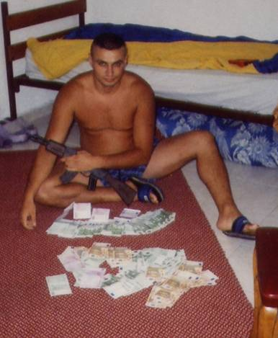
A long term threat?
Left unchecked, traffickers can become a long term problem by buying their way into the economic, political and law enforcement communities.

Slide 16
Who are the traffickers?
Recruiters
Transporters
Exploiters
and others who
  assist the traffickers (e.g., accomplices);
  transfer, harbour or receive trafficked persons;
  knowingly utilise the services of trafficked persons;
  organise or direct other persons to traffic.

Slide 17
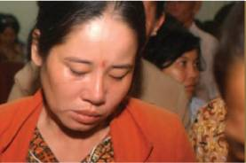
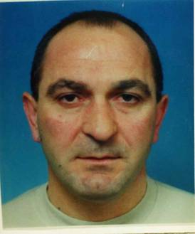
Who are the perpetrators?
International organized crime
Groups trafficking arms, drugs & human beings
Small groups with loose structures (incl. family of the victim)
Your roommate who knowingly exploits the services of a trafficking victims
Leader of a trafficking gang in Cambodia - Sentenced to 15 years confinement for trafficking
Alleged leader of a trafficking gang in Macedonia - Sentenced to 3 years confinement for pimping

Slide 18

Traffickers coerce and control their victims in a number of ways
They lie to victims about future employment, travel, living conditions, treatment or immigration status
Traffickers move victims between different locations to prevent them from developing trust in anyone
They intimidate their victims into providing specific responses for law enforcement personnel
Traffickers use the threat of violence or actually harm victims or the victim’s family

Slide 19
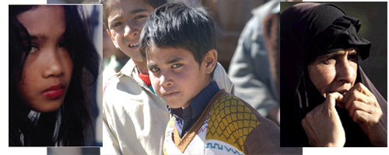
Who are the victims?

Slide 20
Common characteristics of victims
Members of vulnerable groups in the AOR
Members of ethnic groups not common to the AOR
Primarily younger women and children
Poorly educated people
Generally come from economically disadvantaged areas

Slide 21
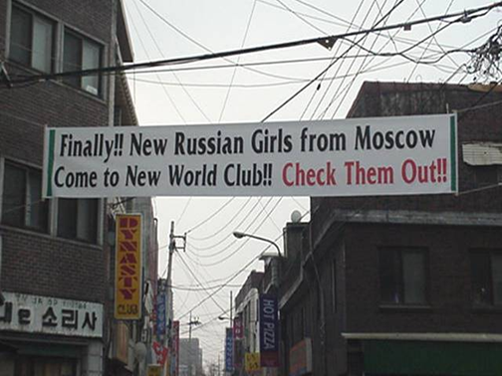
You may encounter victims in ...
  Nightclubs and bars
  Escort services
  Massage parlors
  Hotels and motels
  Private apartments
  Countless other locations
  Streets
  Places, where illegal migrants work
Traffickers are entrepreneurs – they will place their “product” where it is most likely to be sold!

Slide 22
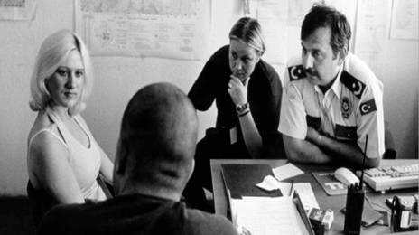
Always remember that victims of THB generally may . . .
Not initiate a conversation on their status
Not respond to or avoid personal questions
Try to make themselves invisible
Be forced to hide the truth about their situation
Not be unaccompanied
Avoid eye contact
Not ask for help
. . . even deny being a
trafficking victim!

Slide 23
Your Responsibility as Commanders & Supervisors
Do not jeopardize
mission accomplishment
and force protection !!!

Slide 24
NATO’s Goals
Raise awareness of the Alliance’s stand against trafficking
Build stability in Areas of Operation (AORs) by reducing destabilizing organized crime
Eliminate any involvement by NATO personnel or contractors with THB by Zero Tolerance Policy
Build credibility through implementation of a comprehensive anti-trafficking policy
Assist host nations to combat THB

Slide 25
Identified challenges for international missions
To create a secure and stable operating environment
To combat organized crime, terrorism and insurgents ― the sources of destabilization
To eliminate the funding for the destabilizing forces

Slide 26
Keep in mind . . .
Members of your mission will be targeted by traffickers because they bring money to the AOR
Traffickers are clever and flexible “business-men” and will develop a wide range of modus operandi
Each AOR requires a tailor-made approach to trafficking
You must consider innovative ways to ensure your people do not have contact with trafficking related businesses entities

Slide 27
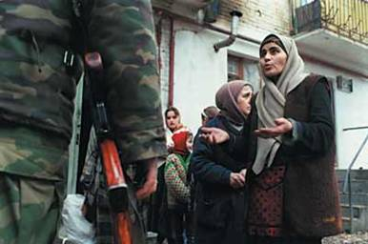
Your responsibilities ...
Set the example
Train your people
Report suspected cases of THB
Ensure appropriate disciplinary action is taken against those who are involved in THB

Slide 28
Handling a suspected trafficking case
When a member of the NATO-led force or a NATO contractor is allegedly involved in a trafficking case
or
When you receive information of a suspected trafficking case that does not directly involve a member of the NATO-led force

Slide 29
Then You must …
Report that information to the force chain of command
Report that information to your national chain of command
Ensure that the mission Legal Advisor and Military Police are aware of the information
Ensure that Civil Military Cooperation (CIMIC) officer is advised of the information
In cases involving your personnel, ensure the case receives an appropriate disciplinary treatment

Slide 30
Remember . . .
Primary responsibility for prosecution of THB cases involving members of your force rests with your national law enforcement processes
Primary responsibility for prosecution of THB cases involving suspects outside your force rests with local law enforcement processes
The best results and most successful outcomes take place when specialized NGOs assist trafficking victims

Slide 31
The anti-trafficking toolbox
PREVENTION
IDENTIFICATION & REFERRAL
REPORTING & DISCIPLINARY MEASURES
SUPPPORT FOR HOST NATION ENFORCEMENT

Slide 32
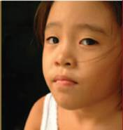
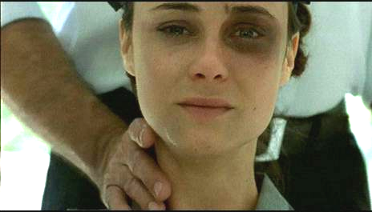

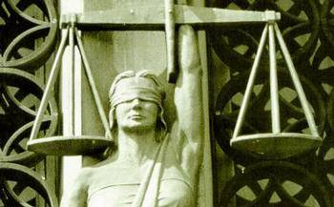
Summary
SUMMARY

Slide 33
NATO Policy on Combating THB
Human trafficking is modern slavery
Human trafficking runs counter to the stabilisation efforts of NATO
NATO-led forces are prohibited from engaging in human trafficking
NATO has a zero tolerance policy towards THB and involvement could end your career

Slide 34
NATO Policy on Combating THB
All personnel will receive training
NATO-led forces will provide support to responsible authorities within their competence and mandate
NATO and partner nations will incorporate contractual provisions that prohibit its contractors from engaging in THB
NATO and partner nations commit themselves to ensure full national implementation of the NATO Policy
Non NATO troop contributing nations must commit themselves to the anti-THB policy upon joining a NATO–led operation

Slide 35
As a commander and leader,
you play an important role . . .
Ensure your people receive training
Institute management procedures to minimize contact with the exploitation associated with THB
Report suspected cases of THB involving your people or others
Ensure that cases involving members of your force receive appropriate disciplinary or criminal treatment

Slide 36








NATO wishes to acknowledge the assistance of the following organizations throughout the conceptualizing and drafting process:
GCSP – Geneva Centre
for Security Policy
GTZ – Deutsche Gesellschaft
für Technische Zusammenarbeit
IOM – International Organization
for Migration
EUPM – European Union Police Mission to Bosnia and Herzegovina
Reaching Out – Romania
BMLV/LVAk – Austrian National Defense Academy
UNOHCHR - United Nations Office of
the High Commissioner for Human Rights
UNDPKO - United Nations Department
for Peacekeeping Operations
UNODC - United Nations Office
on Drugs and Crime
and with the support of the Norwegian and US Delegations to NATO

Slide 37
Questions ?

